Slide 1

HOW TO
CHANGE THE WORLD
IN A WEEKEND
ROB SPECTRE
@dN0t

Slide 2
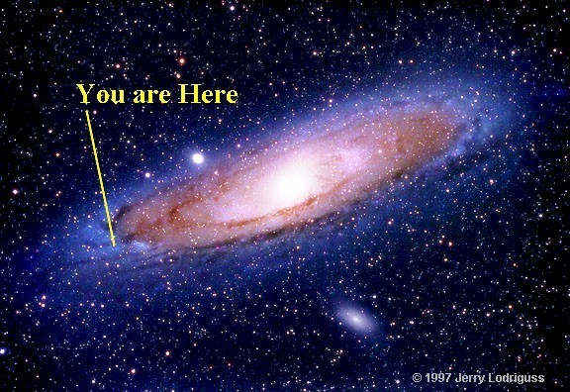
SO.
HERE YOU ARE

Slide 3

LOOK WHAT YOU AREN'T
GETTING THIS WEEKEND

Slide 4
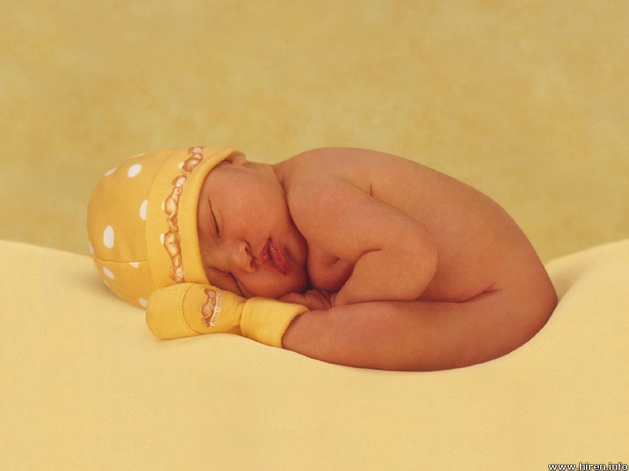
YOU AREN'T GETTING
SLEEP

Slide 5
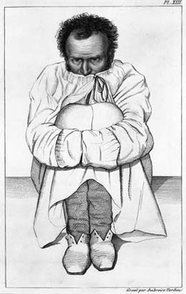
YOU AREN'T GETTING
SANITY

Slide 6
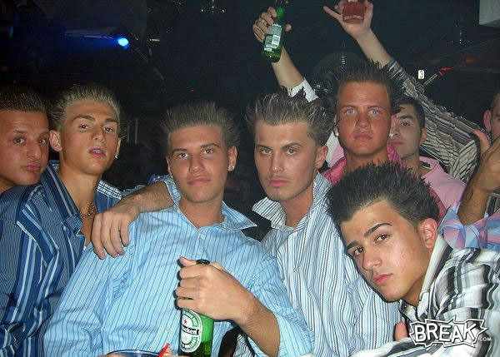
YOU AREN'T GETTING
BOTTLE SERVICE

Slide 7
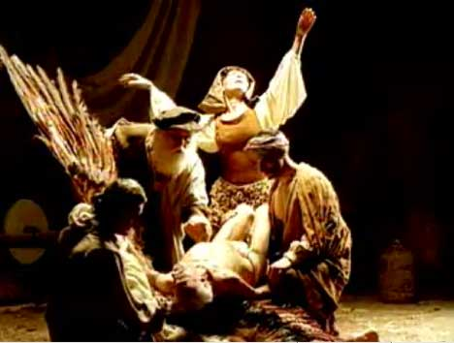
YOU ARE LOSING
MY RELIGION

Slide 8

MY KIND OF
MUTANT

Slide 9
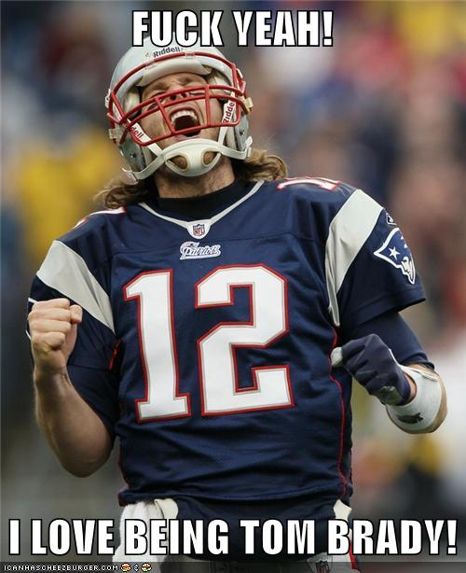
MY KIND OF
HERO

Slide 10
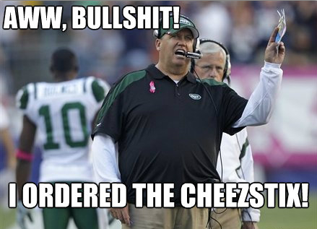
MY KIND OF
2-3 START

Slide 11

BRING THE
THUNDER

Slide 12
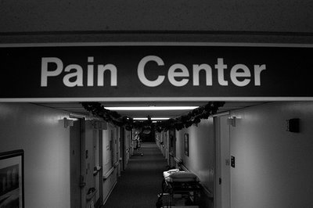
DELIVER THE
PAIN

Slide 13
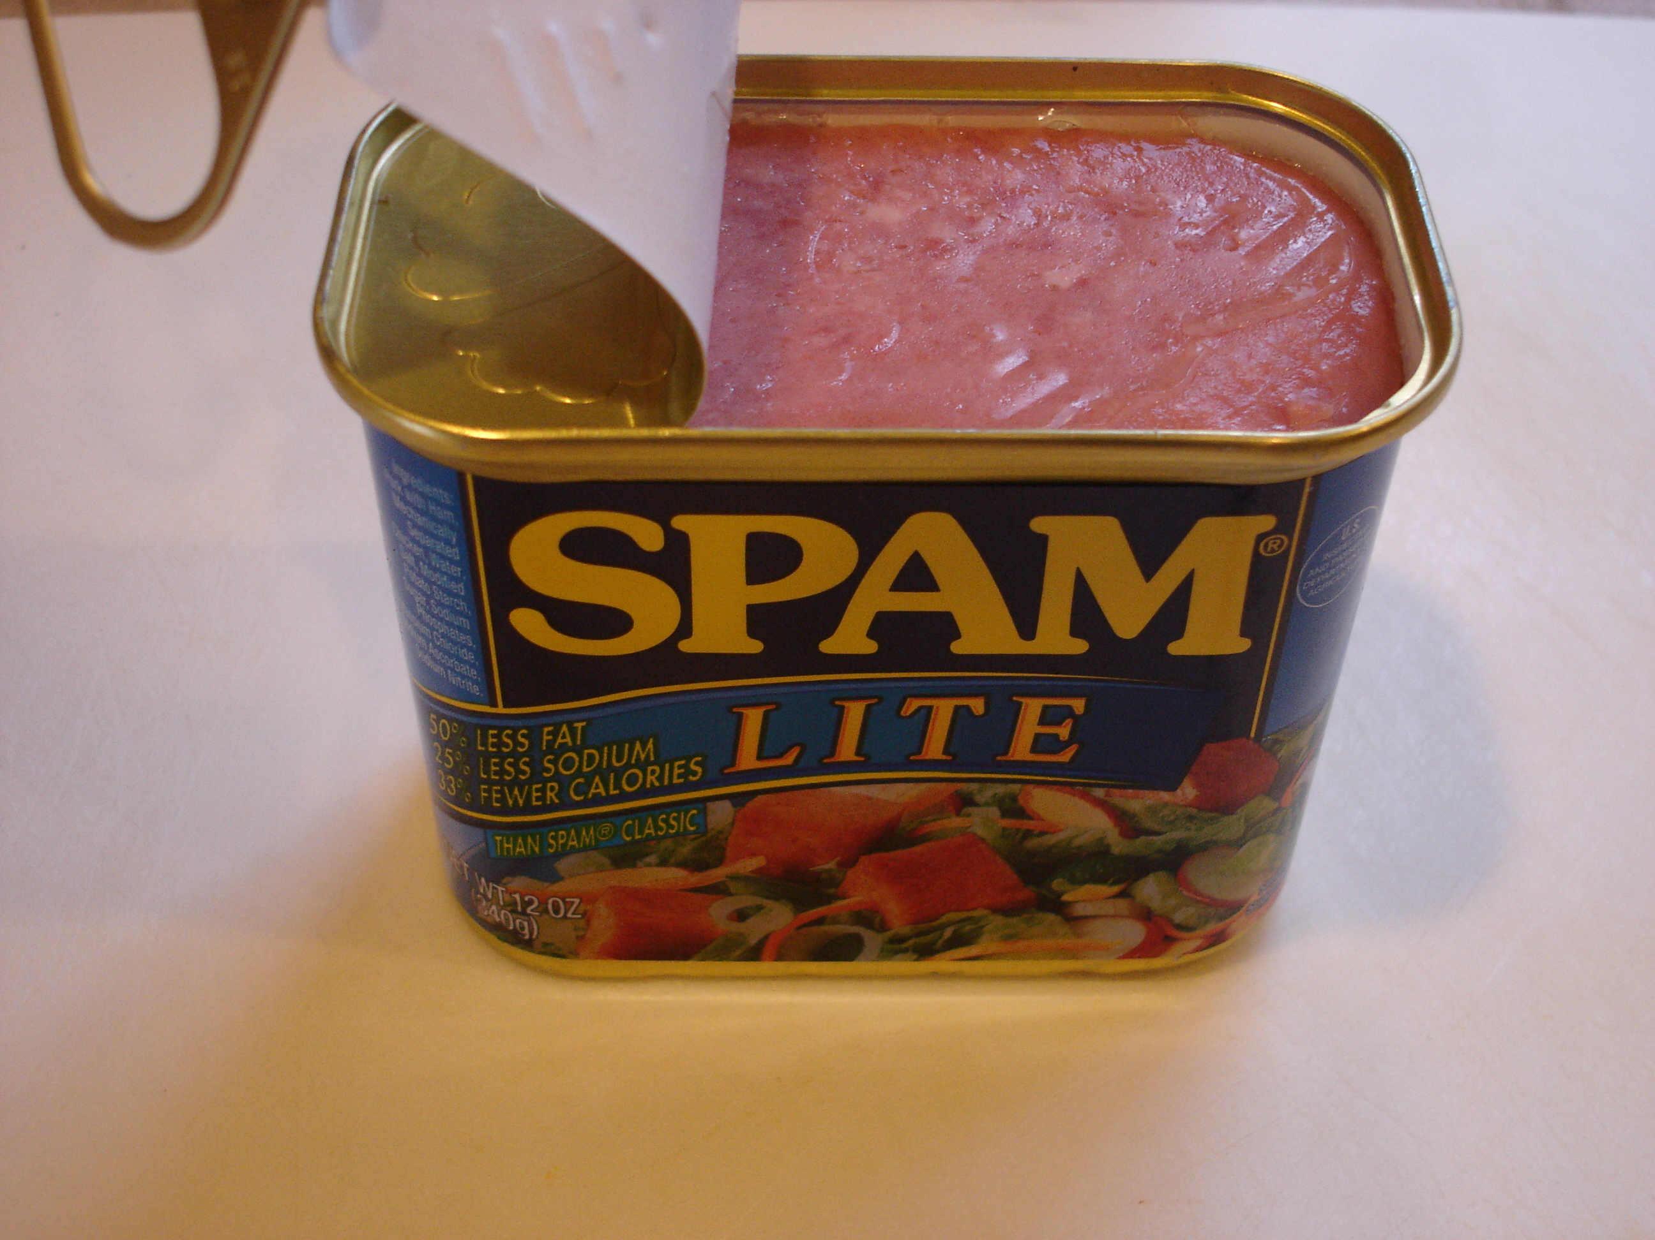
OPEN A
CAN

Slide 14
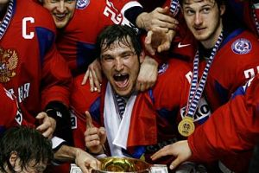
TAKE HOME THE
GOLD

Slide 15
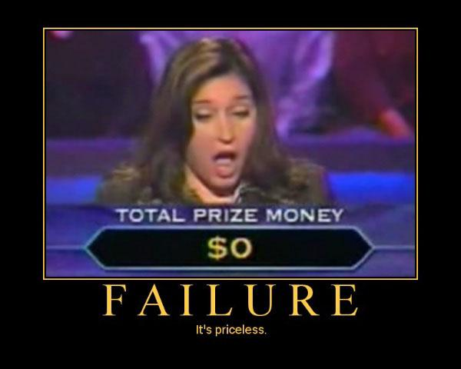
GOOD LUCK
WITH THAT

Slide 16
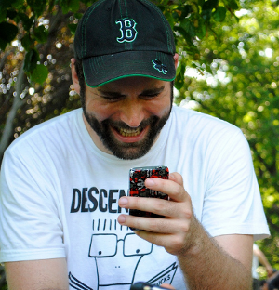
OH
HAI

Slide 17

BEEN AT THIS
A WHILE

Slide 18
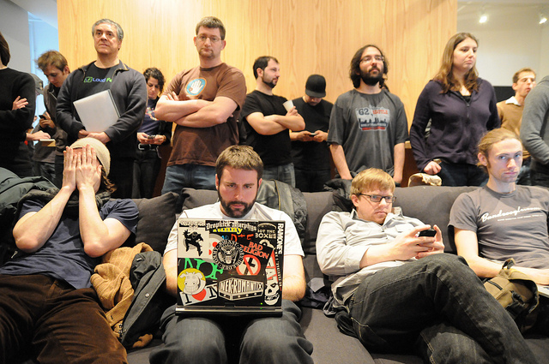
MY MA WOULD HAVE
PREFERRED THE TIMES

Slide 19

IS THIS EVEN
POSSIBLE?

Slide 20

JUST
CHEAT

Slide 21

JUMP THE
GUN

Slide 22

BRING YOUR FRIEND
SEAN

Slide 23
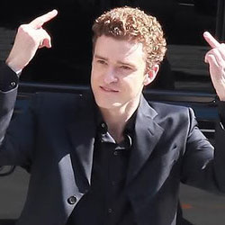
BRING YOUR FRIEND
JUSTIN

Slide 24
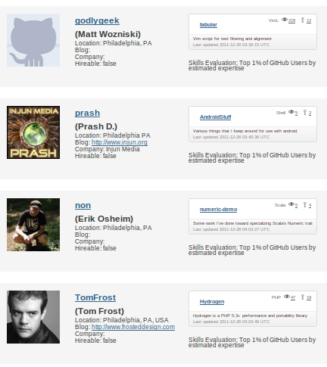
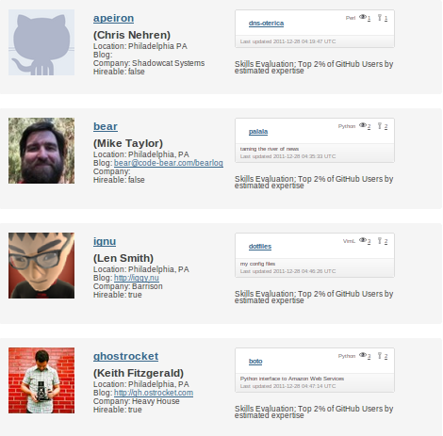
STACK THE
DECK

Slide 25
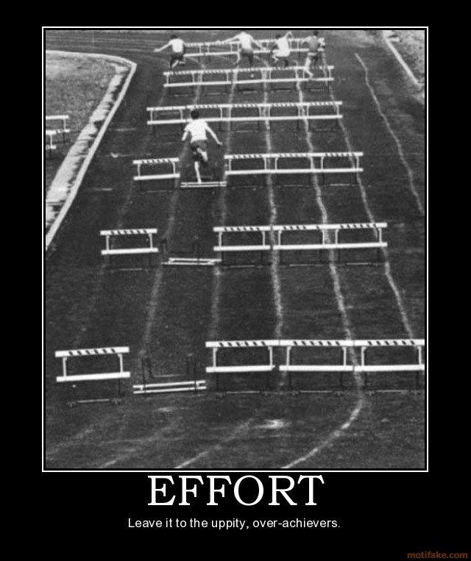
NOT CHEATING
IS HARDER

Slide 26
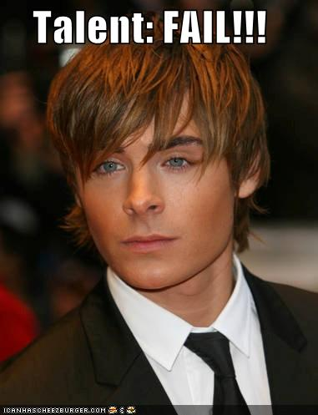
NOT CHEATING MEANS
TALENT

Slide 27
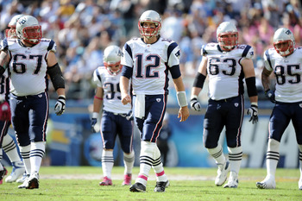
NOT CHEATING MEANS
TEAMWORK

Slide 28
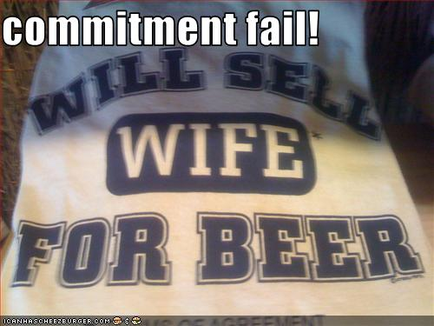
NOT CHEATING MEANS
COMMITMENT

Slide 29
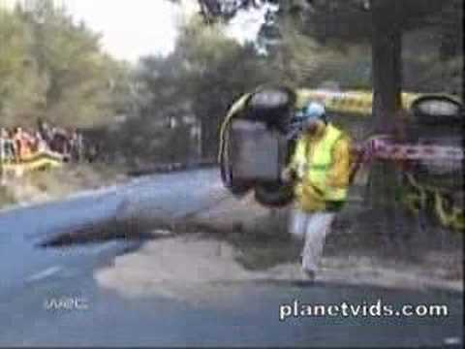
NOT CHEATING MEANS
LUCK

Slide 30

WORLD CHANGE MEANS
SERIOUS BUSINESS

Slide 31
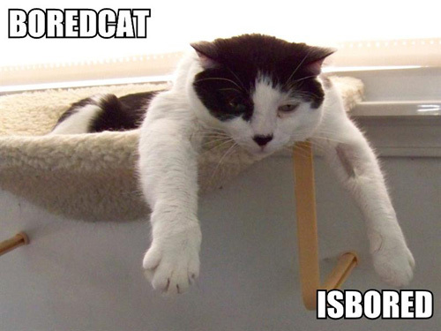
ARE WE SERIOUSLY
32 SLIDES IN?

Slide 32

UNLESS WHAT YOU KNOW
IS HARD TIME

Slide 33
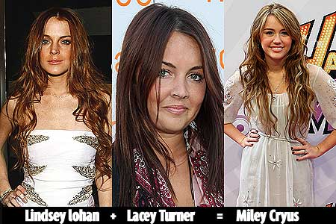
FAMILIAR
FACES

Slide 34
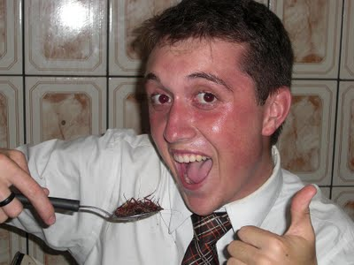
TRYING SOMETHING
NEW

Slide 35

GET TO THE DEMO,
MAN.

Slide 36
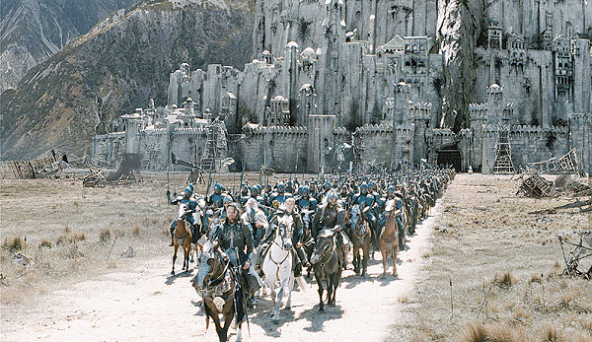
YOU'RE NOT BUILDING
A CASTLE

Slide 37
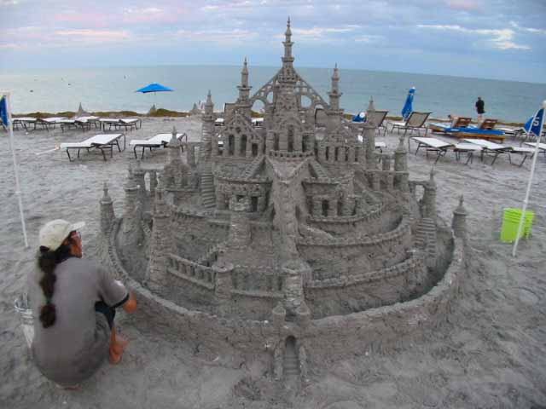
YOU'RE NOT BUILDING
A SANDCASTLE

Slide 38

YOU'RE NOT BUILDING
A BUCKET OF RAINBOWS

Slide 39
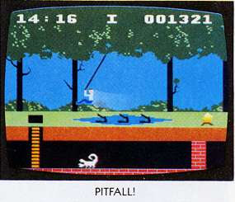
AVOID COMMON
PITFALLS

Slide 40
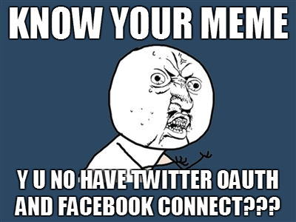
OAUTH IS A ROUGH
FIRST RODEO

Slide 41
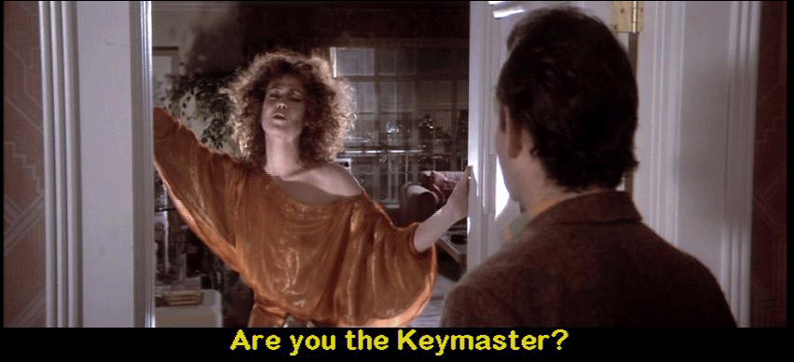
USERS ARE
NO JOKE

Slide 42
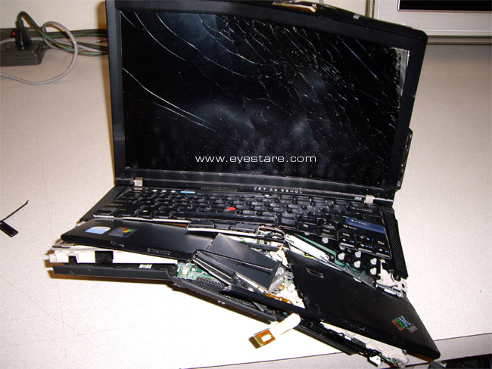
IT IS BROKEN IF
IT IS ON YOUR LAPTOP

Slide 43
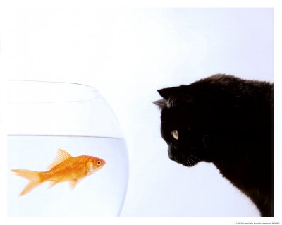
EYE ON THE
PRIZE

Slide 44

THE ZEN
OF HACKATHONS

Slide 45
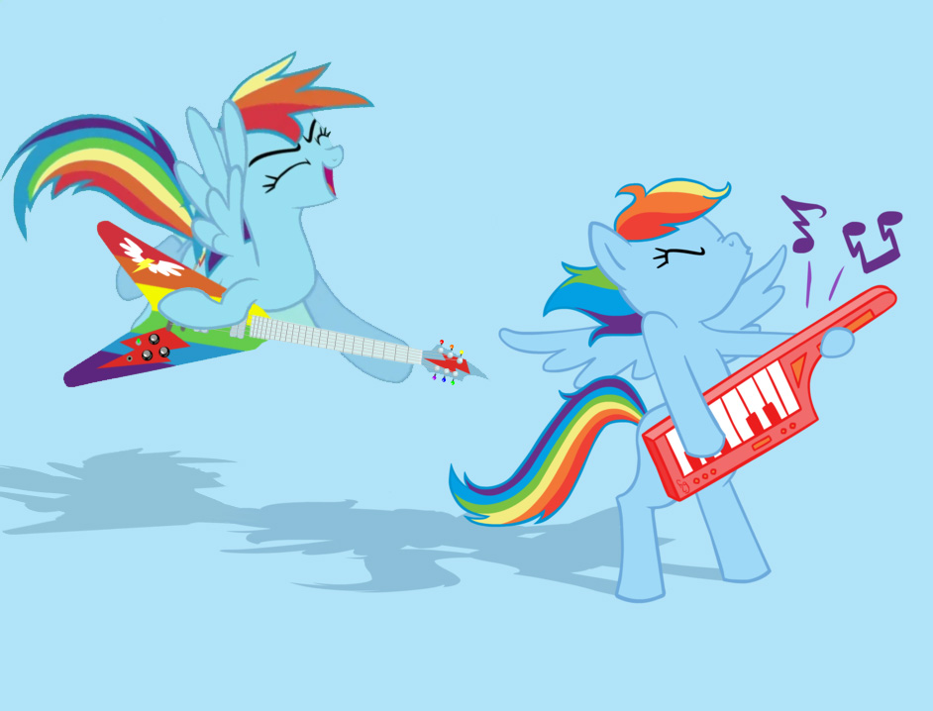
DOUBLE RAINBOW
ALL THE WAY

Slide 46
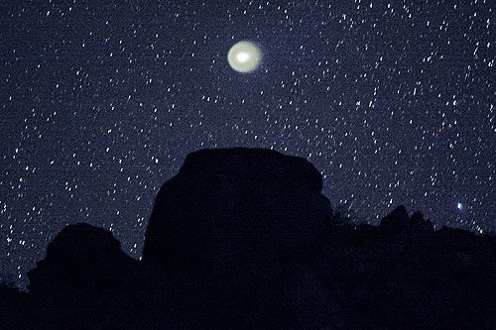
MOST SENTIMENTAL
SLIDE OF THE DECK

Slide 47
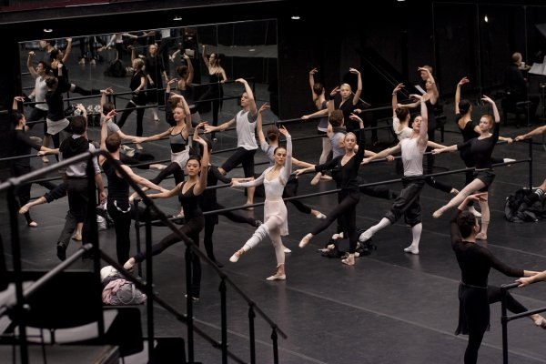
REHEARSE REHEARSE
REHEARSE

Slide 48

FOUR MINUTES OF
OF CHRISTOPHER PLUMMER

Slide 49
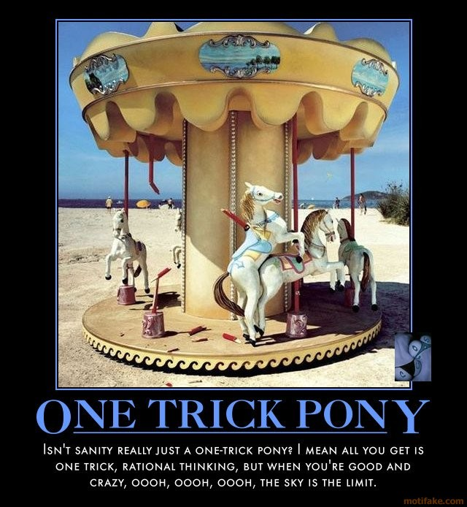
ONE TRICK
PONY

Slide 50

PARTY
HARD

Slide 51
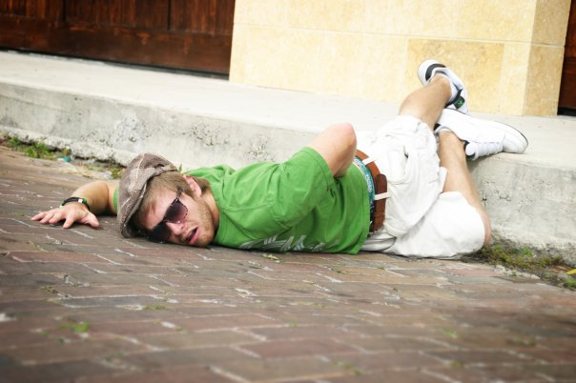
THERE ARE WORSE WAYS
TO SPEND THE WEEKEND

Slide 52
GITHUB.COM/RobSpectre/Talks
@dN0t
RSPECTRE @TWILIO.COM
BROOKLYNHACKER.COM

Slide 53
THANK
YOU!

